Slide 1
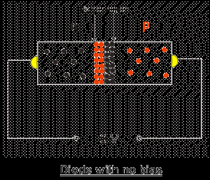
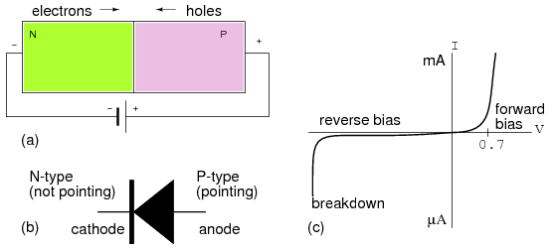
Diodes

Slide 2
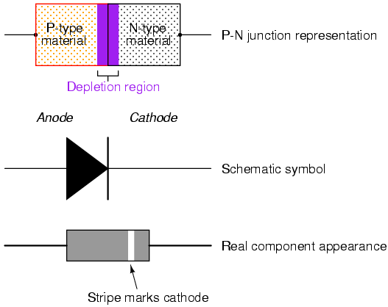
Diode
Diodes are electronic devices created by bringing together a p-type and n-type region within the same semiconductor lattice.

Slide 3
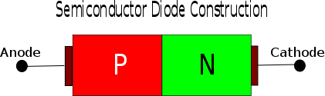
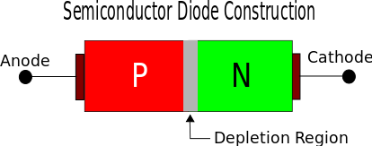
Diode Construction
A diode is formed by joining two equivalently doped P-Type and N-Type semiconductor. The P-Type semiconductor has excess holes (positive charge). The N-Type semiconductor has excess electrons.
At the junction, the holes in the P-Type attract electrons in the N-Type material. Hence the electron diffuses and occupies the holes in the P-Type material. Causing a small region of the N-type near the junction to loose electrons and behaves like intrinsic semiconductor material, in the P-type a small region gets filled up by holes and behaves like a intrinsic semiconductor.
This depletion region becomes an insulating layer.

Slide 4
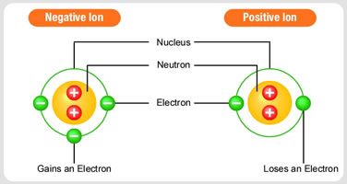
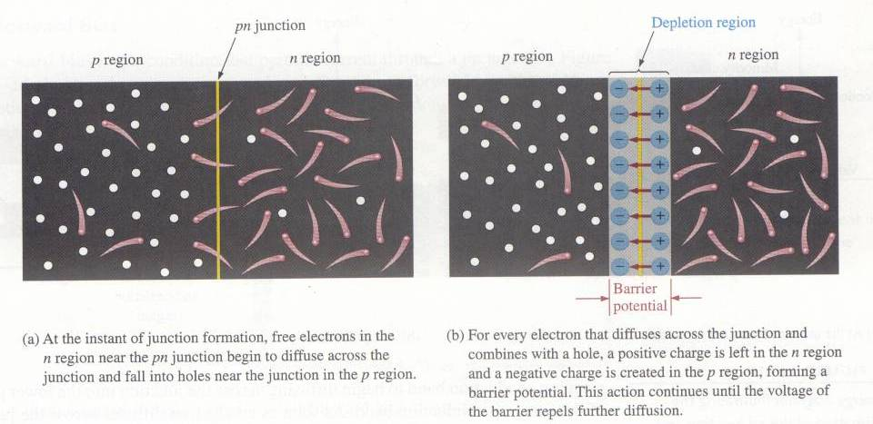
The PN-Junction
The interface in-between p-type and n-type material is called as
pn-junction.

Slide 5
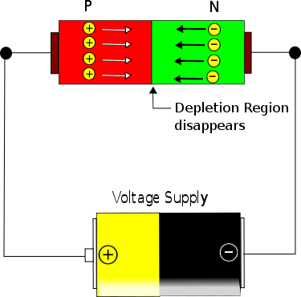
Forward Bias
In forward bias the P-Region of the diode is connected with the positive terminal of the battery and N-region is connected with the negative region.
During the forward bias the following process occurs. The positive of the battery pumps more holes into the P-region of the diode. The negative terminal pumps electrons into the N-region.
The excess of charge in P and N region will apply pressure on the depletion region and will make it shrink. As the voltage increases the depletion layer will become thinner and thinner and hence diode will offer lesser and lesser resistance. Since the resistance decreases the current will increase (though not proportional to the voltage).
At one particular voltage level (V_{f} called as threshold / cut-off voltage) the depletion layer disappears and from this point on the diode starts to conduct very easily. From this point on the diode, current increases exponentially to the voltage applied.

Slide 6
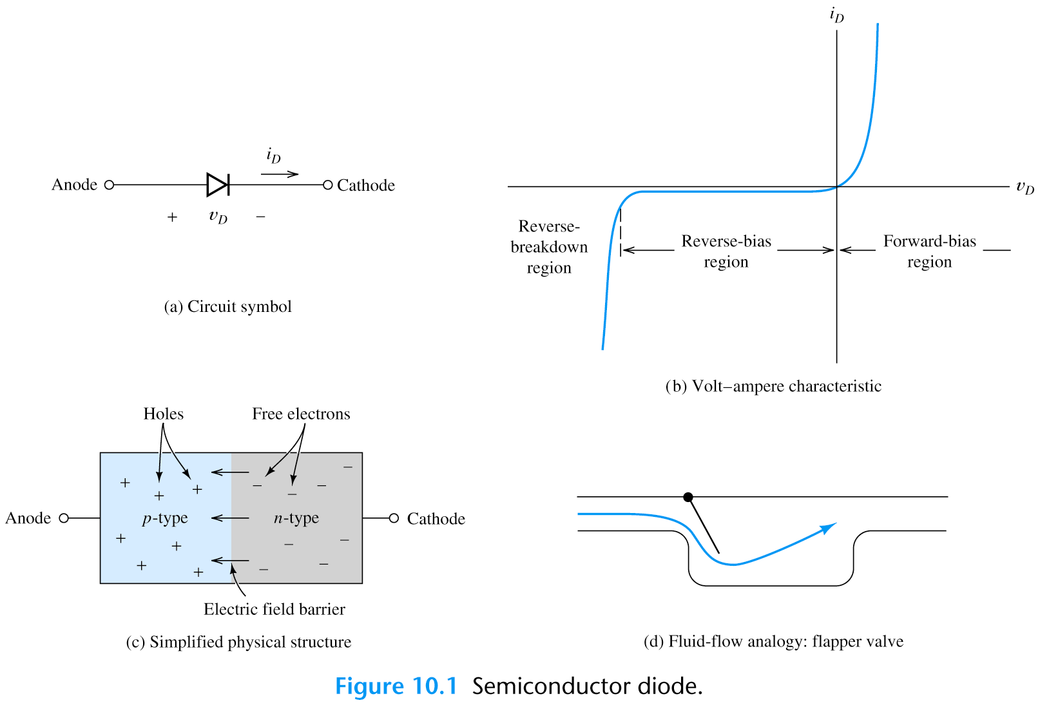
Biasing the PN-Junction
Forward Bias:

Slide 7
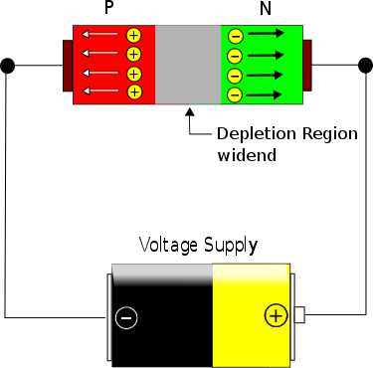
Reverse Bias
In reverse bias the P-type region is connected to negative voltage and N-type is connected to positive terminal as shown above. In this condition the holes in P-type gets filled by electrons from the battery / cell (in other words the holes get sucked out of the diode).
The electrons in N-type material is sucked out of the diode by the positive terminal of the battery. So the diode gets depleted of charge. So initially the depletion layer widens (see image above) and it occupies the entire diode. The resistance offered by the diode is very huge. The current that flows in reverse bias is only due to minority charge which is in nano amperes in silicon and micro amperes in high power silicon and germanium diodes.

Slide 8
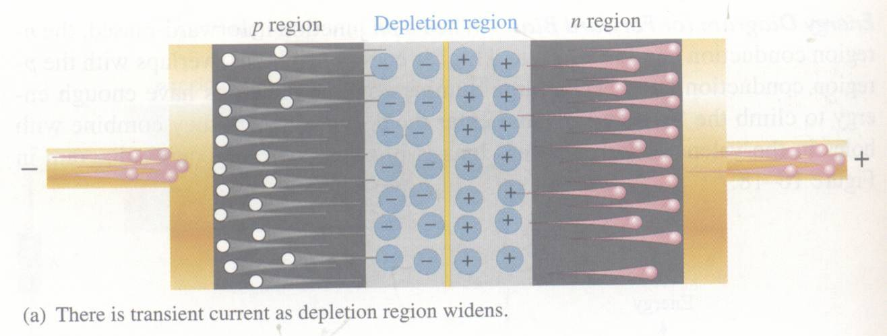
Reverse Bias
DC voltage negative terminal connected to the p region and positive to the n region. Depletion region widens until its potential difference equals the bias voltage, majority-carrier current ceases.

Slide 9
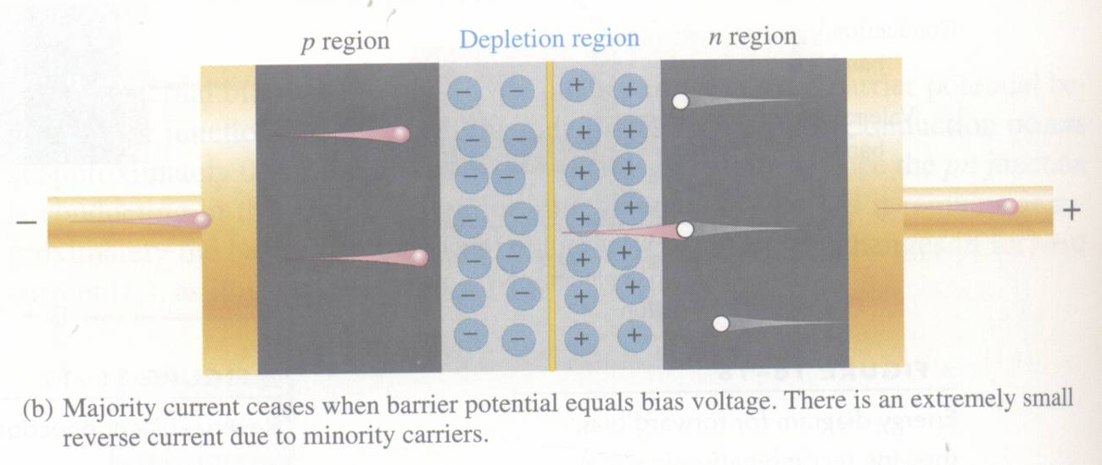
Reverse Bias
Majority-carrier current ceases.
However, there is still a very small current produced by minority carriers.

Slide 10
Biasing the PN-Junction
Reverse Breakdown: As reverse voltage reach certain value, avalanche occurs and generates large current.
If the reverse voltage is made high enough, then the junction will break down and electrons will flow from anode to cathode (under normal conditions, electrons flow from cathode to anode, when forward biased).

Slide 11
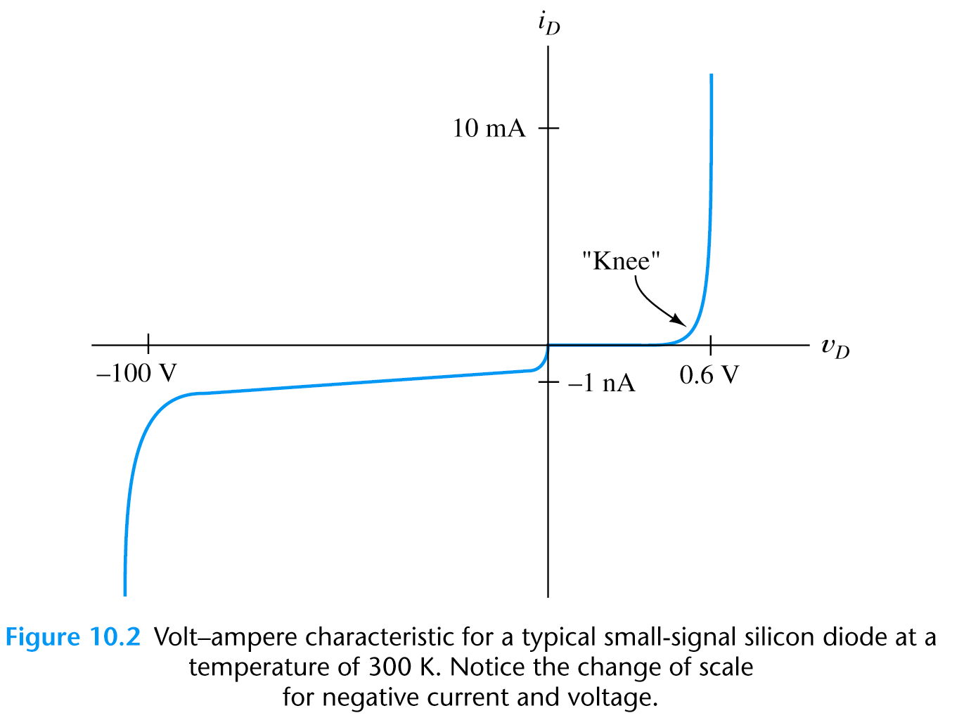
The Diode Characteristic I-V Curve

Slide 12
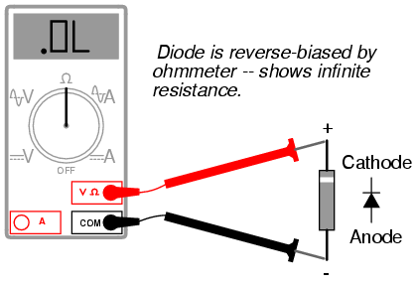
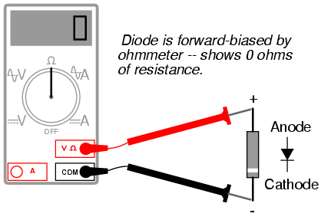
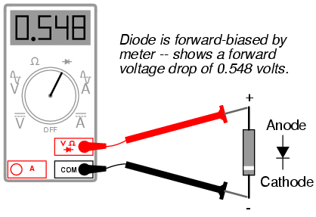
Diode – Characteristic

Slide 13
Shockley Equation
* The Shockley equation is a theoretical result under certain simplification:
Geometry, doping and material constants are lumped in I_{s}

Slide 14
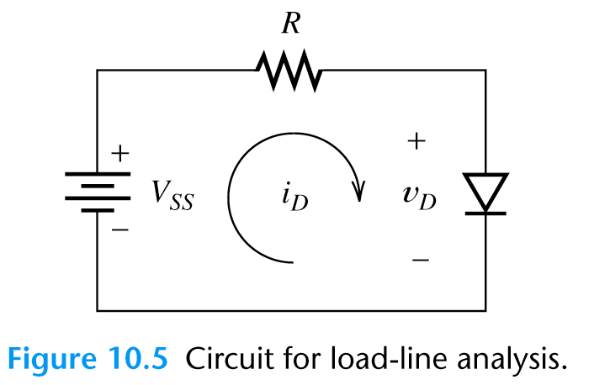
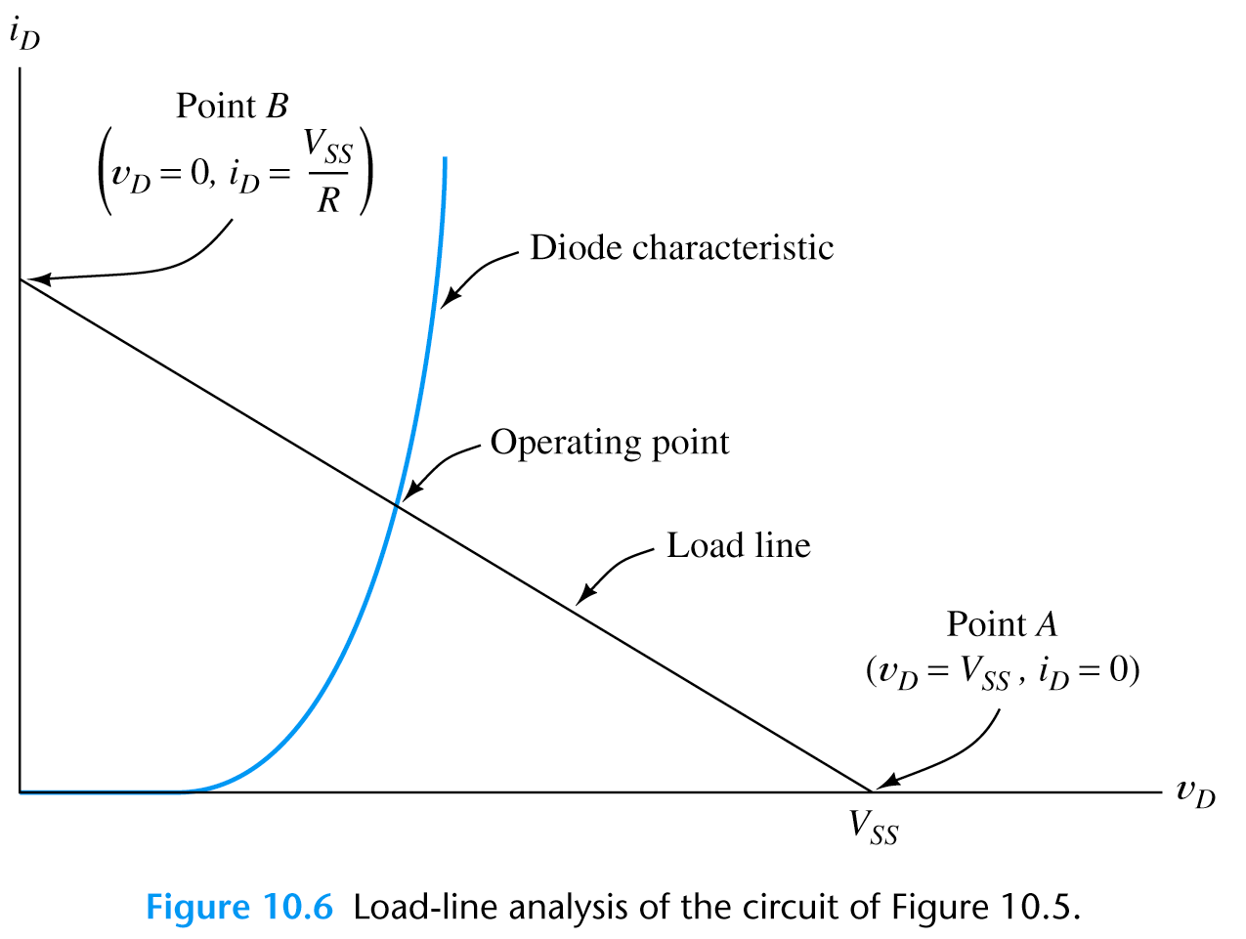
Load-Line Analysis of Diode Circuit

Slide 15
Example Load-Line Analysis
1.3mA
0.7

Slide 16
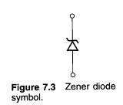
The Zener Diode
* Zener diode is designed for operation in the reverse-breakdown region.
* The breakdown voltage is controlled by the doping level (-1.8 V to -200 V).
* The major application of Zener diode is to provide an output voltage that is stable despite changes in input voltage – power supplies, voltmeter,…

Slide 17
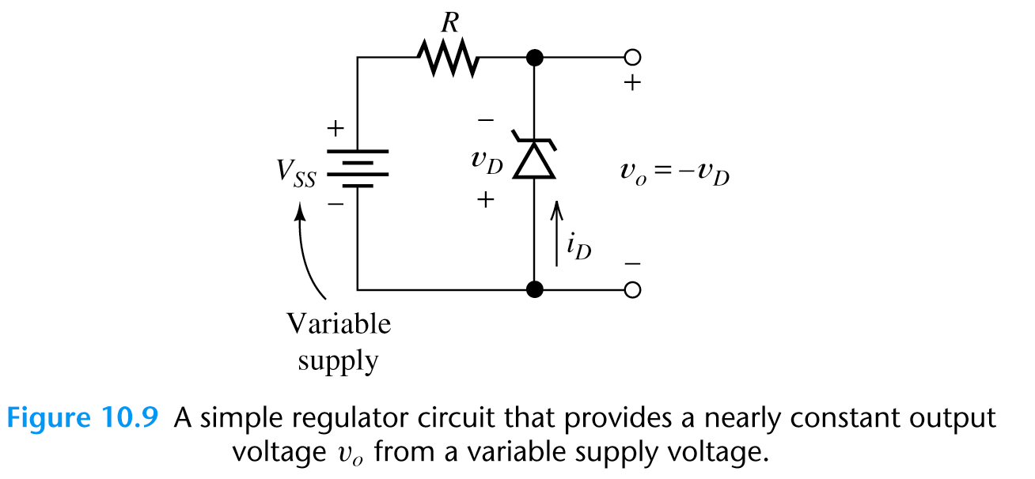
Zener-Diode Voltage-Regulator Circuits
Sometimes, a circuit that produces constant output voltage while operating from a variable supply voltage is needed. Such circuits are called voltage regulator.
The resistor limits the diode current to a safe value so that Zener diode does not overheat.
The Zener diode has a breakdown voltage equal to the desired output voltage.

Slide 18
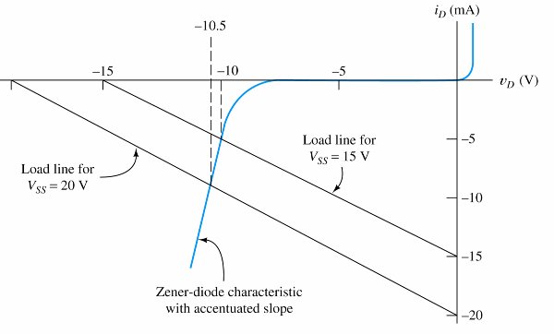
Example – Zener-Diode Voltage-Regulator Circuits
Actual Zener diode
performs much better!

Slide 19
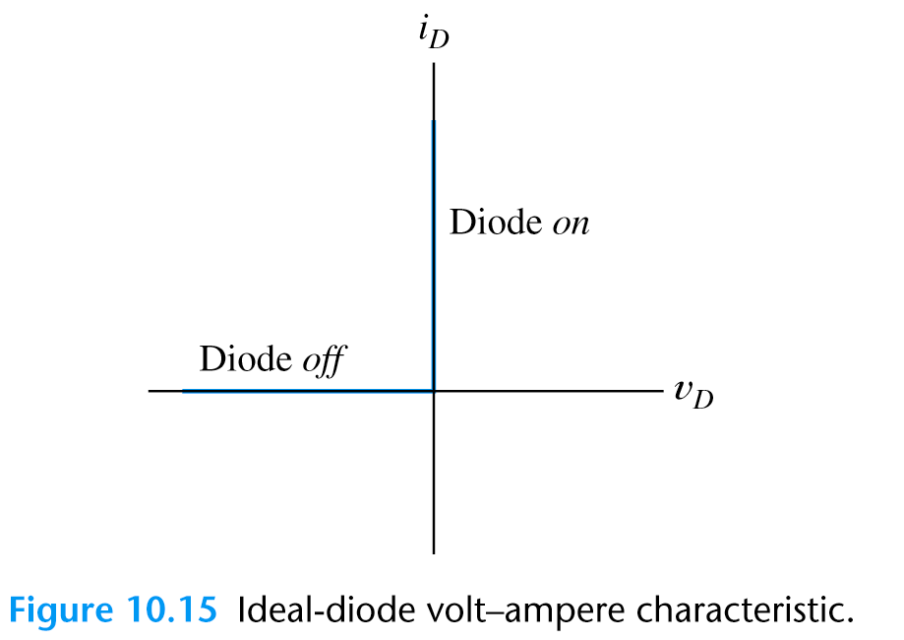
Ideal-Diode Model (1)
* Graphical load-line analysis is too cumbersome for complex circuits,
We may apply “Ideal-Diode Model” to simplify the analysis:
(1) in forward direction: short-circuit assumption, zero voltage drop;
(2) in reverse direction: open-circuit assumption.
* The ideal-diode model can be used when the forward voltage drop and reverse currents are negligible.

Slide 20
Ideal-Diode Model
* In analysis of a circuit containing diodes, we may not know in advance which diodes are on and which are off.
* What we do is first to make a guess on the state of the diodes in the circuit:

Slide 21
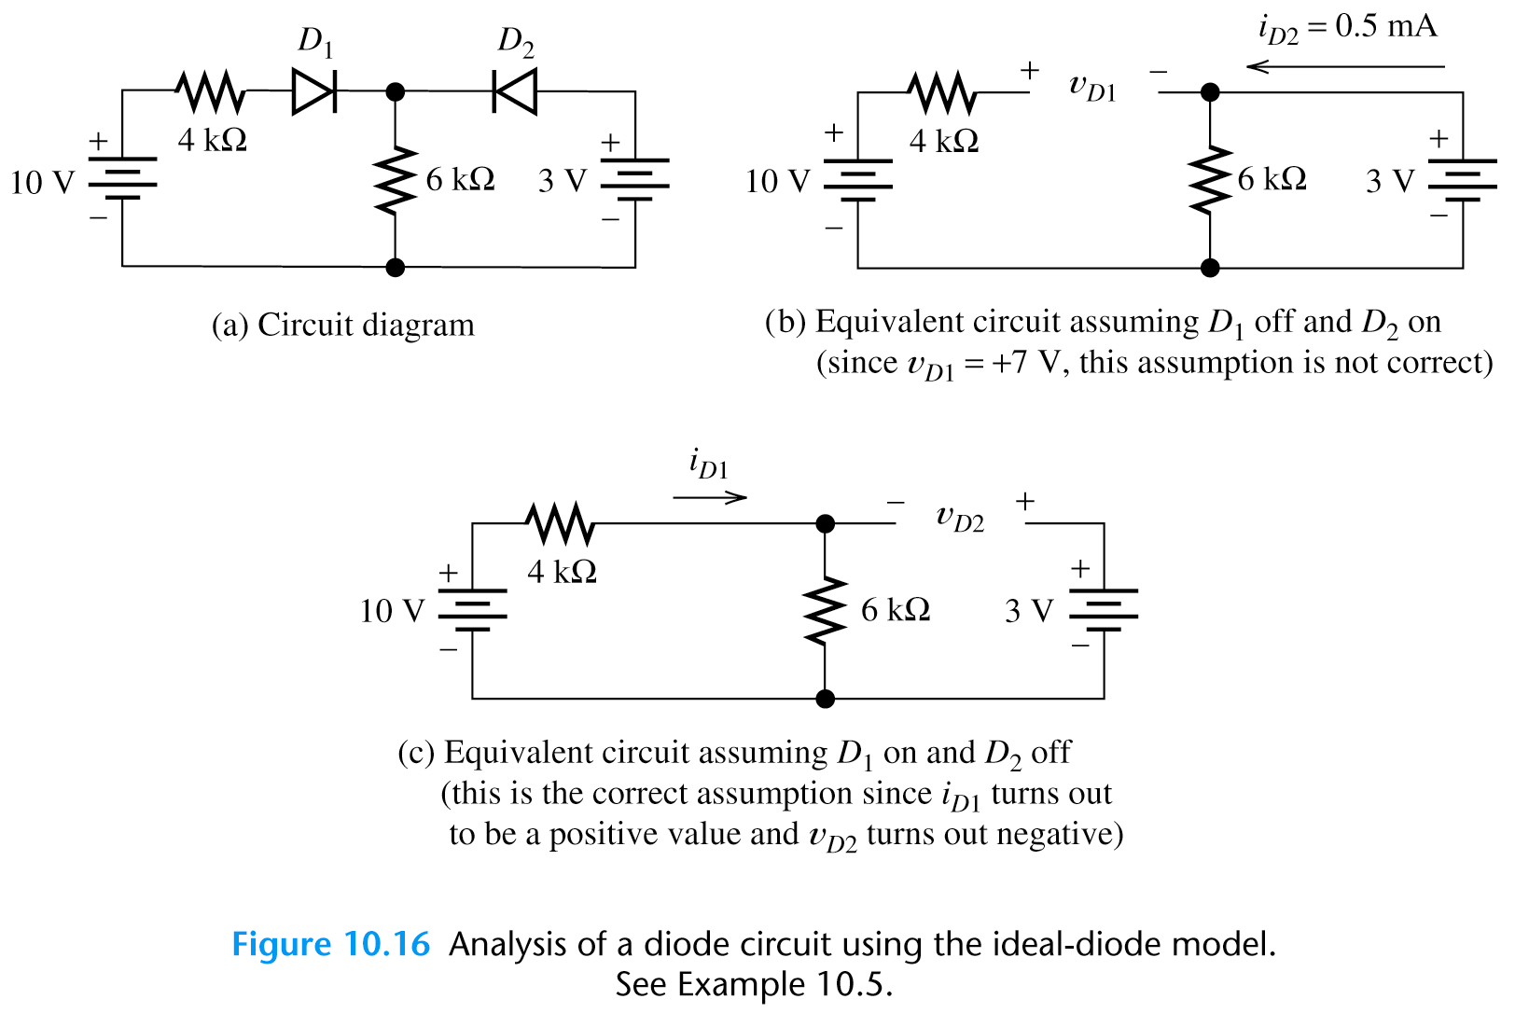
When forward biased, the ideal diode is simply a short circuit
Example – Analysis by Assumed Diode States

Slide 22
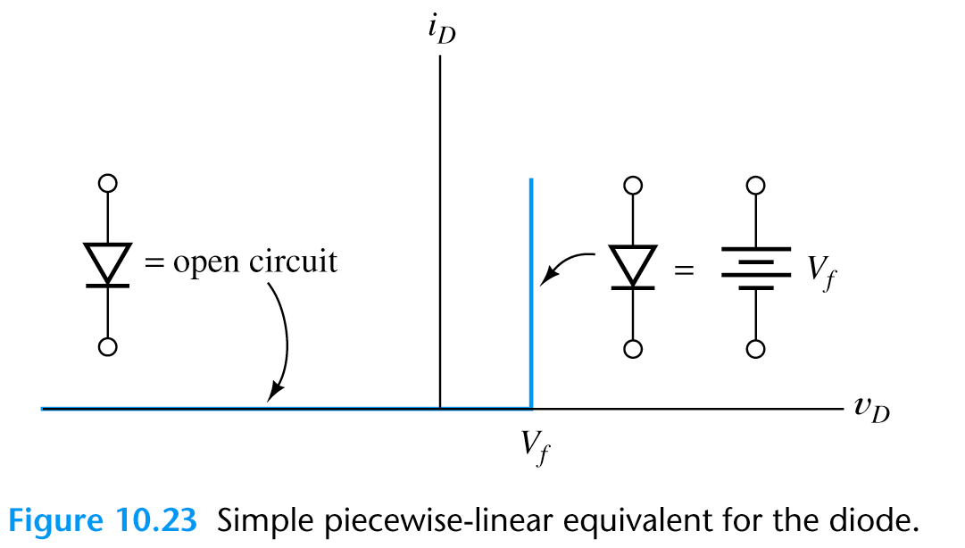
Modified Ideal-Diode Model (2)
Modified ideal-diode model is usually accurate enough in most of the circuit analysis.
Ideal-Diode Model
Modified Ideal-Diode Model

Slide 23
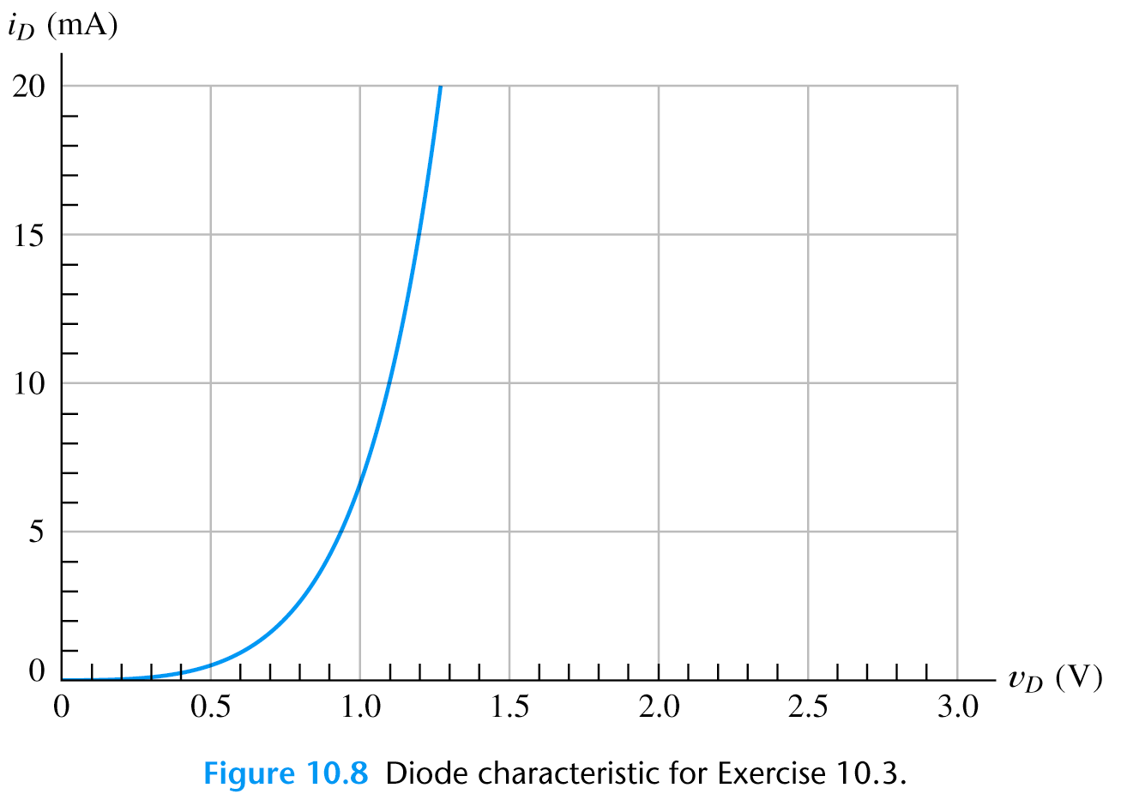
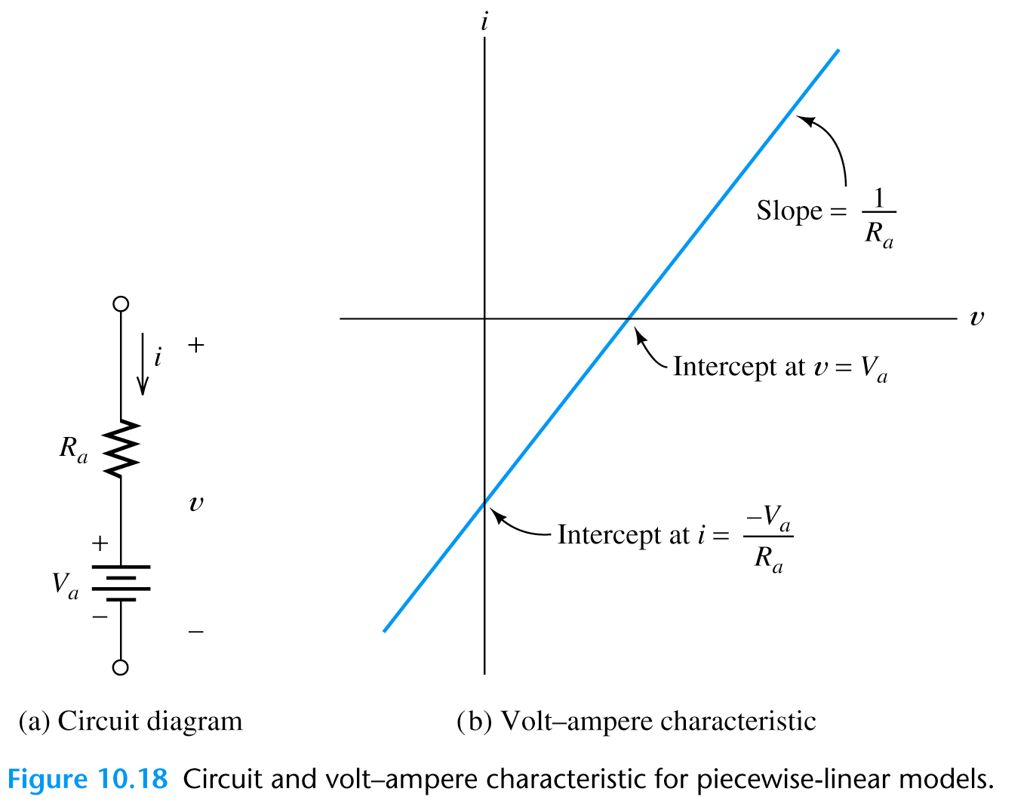
Piecewise Linear Diode Model (3)
More accurate that the ideal diode model and do not relies on nonlinear
equation or graphical techniques.
(1) Diode V-I curve approximated by
straight line segments
(2) We model each section of the diode
I-V curve with resistor (R_{a}) in series with a fixed voltage source (V_{a})
v = R_{a}i + V_{a}

Slide 24
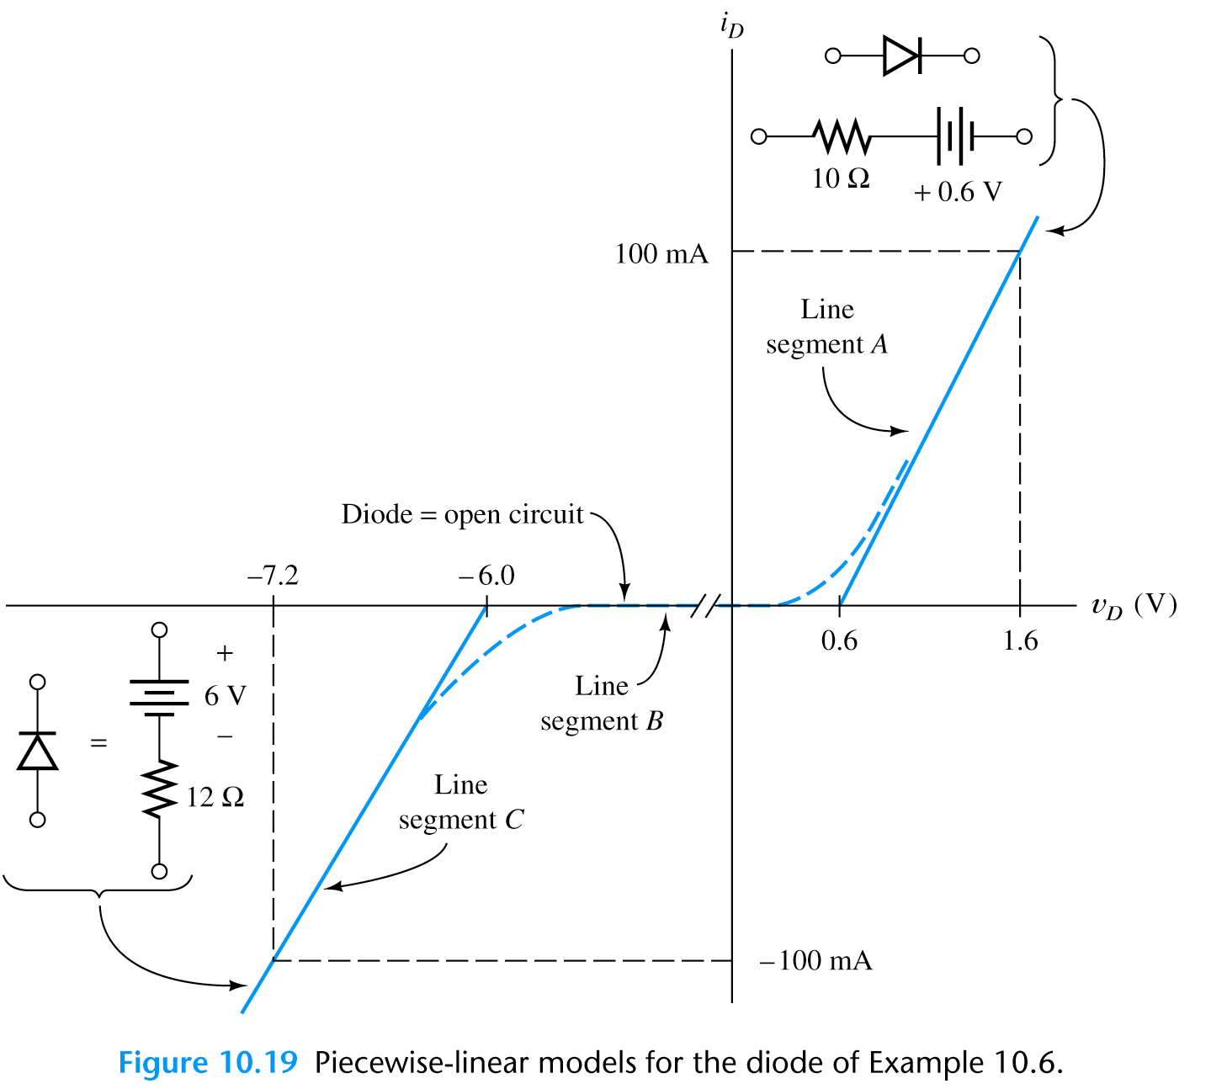
Problem Find circuit models for the Zener-diode volt-ampere curve shown in figure below using the piecewise-linear diode model.
Draw a line
Look for intercept (0.6V) & the reciprocal of the slope (1/R)
(1.6V-0.6V)/100mA=10Ω
Open circuit approximation
Repeat for the reverse bias

Slide 25
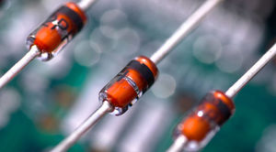
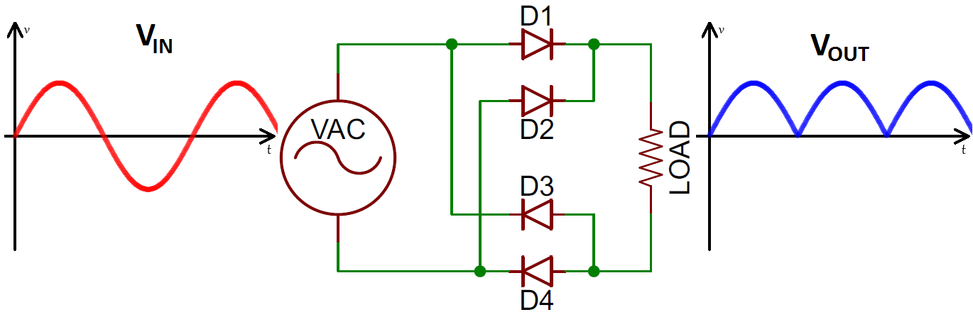
Diode Applications

Slide 26
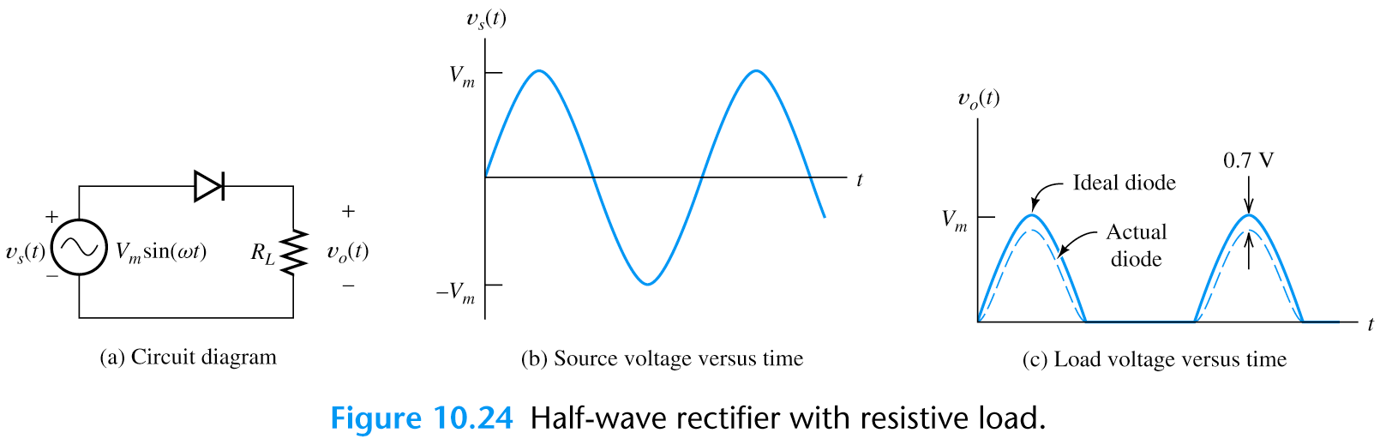
Rectifier Circuits
* Rectifiers convert AC power to DC power.
* Rectifiers form the basis for electronic power suppliers and battery charging circuits.
Half-Wave Rectifier

Slide 27
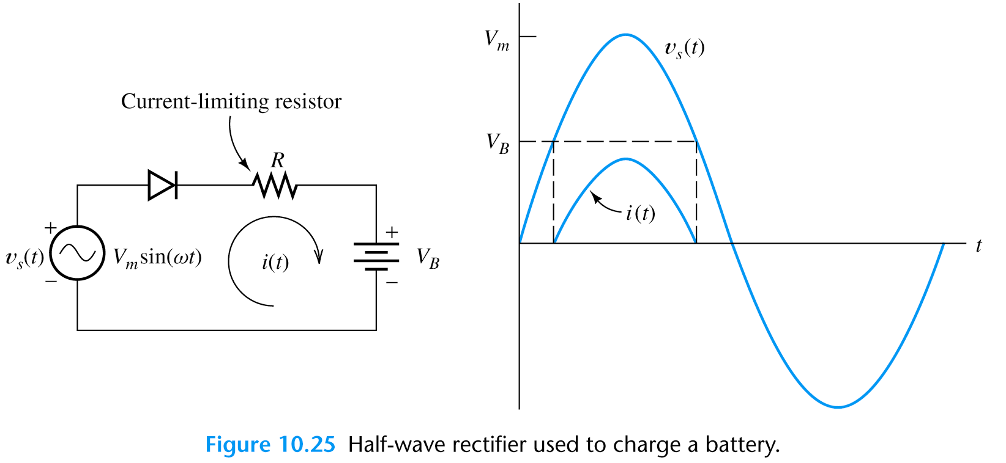
Basic Battery-Charging Circuit
The current flows only in the direction that charges the battery.

Slide 28
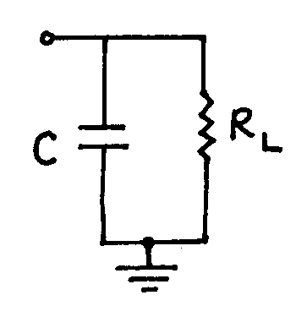
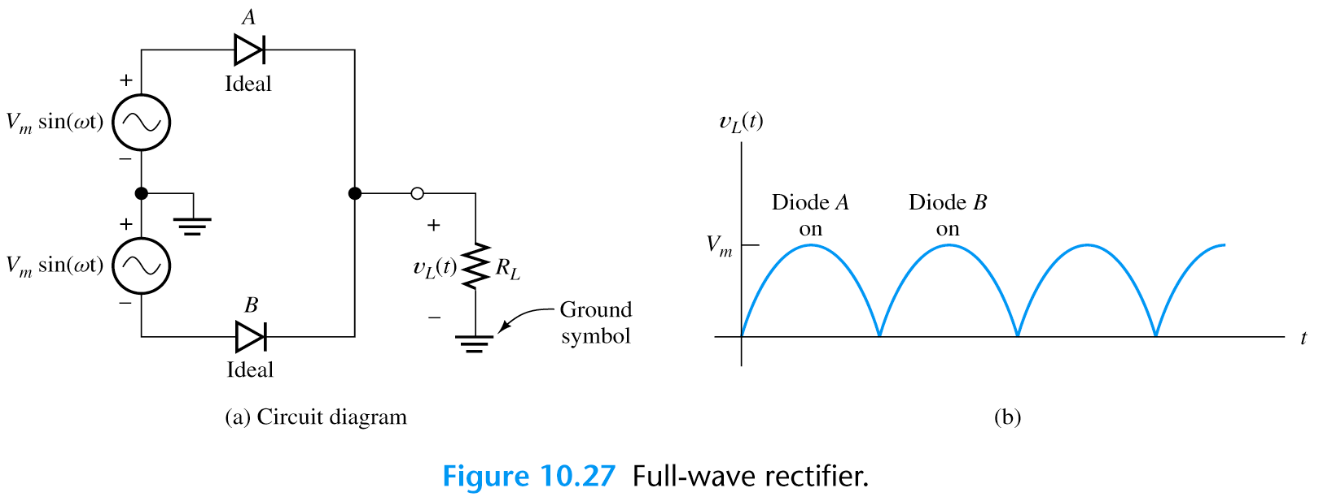
We can also smooth the output by using a large capacitance.
Full-Wave Rectifier Circuits
Two half-wave rectifier with a common ground.
When upper source supplies “+” voltage to diode A, the lower source supplies “-” voltage to diode B; and vice versa.

Slide 29
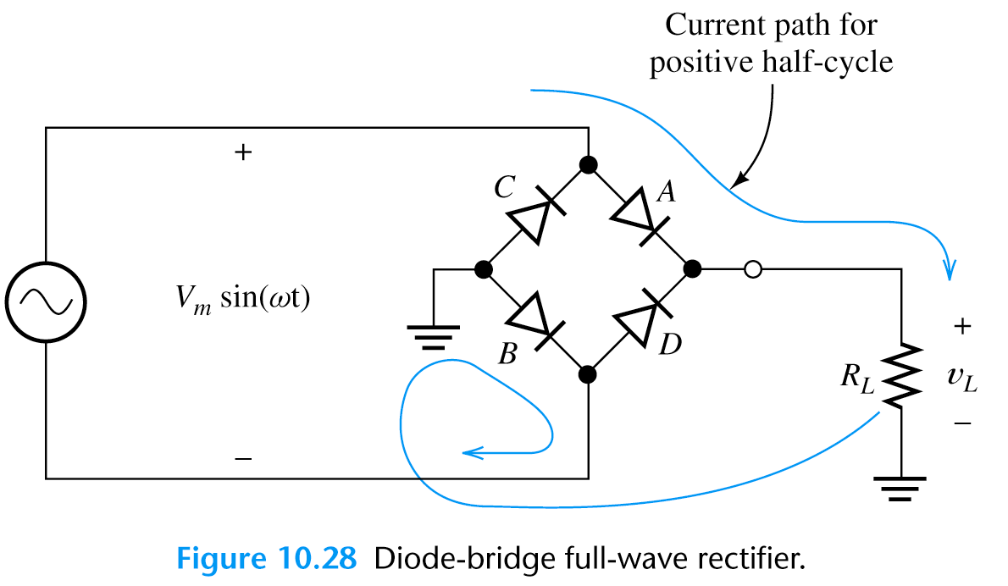
Full-Wave Rectifier Circuits
* The Diode-Bridge Full-Wave Rectifier
We can also smooth the output by using a large capacitance.
A,B
C,D

Slide 30
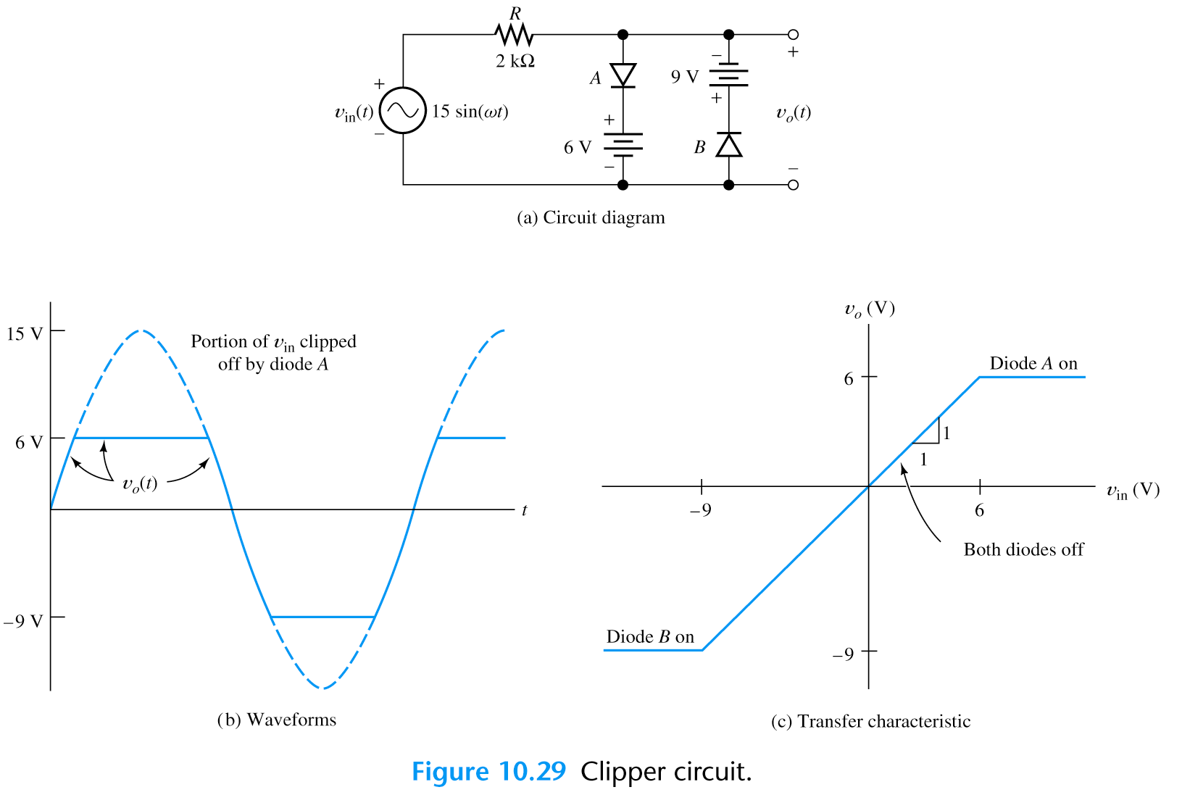
Wave-Shaping Circuits
Clipper Circuits
* A portion of an input signal waveform is “clipped” off.

Slide 31
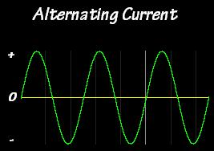
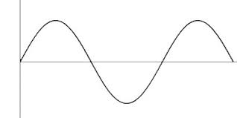
Small Signal Analysis of Diode

Slide 32
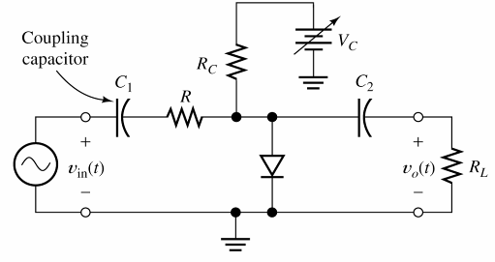
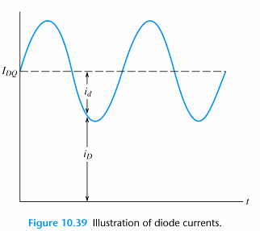
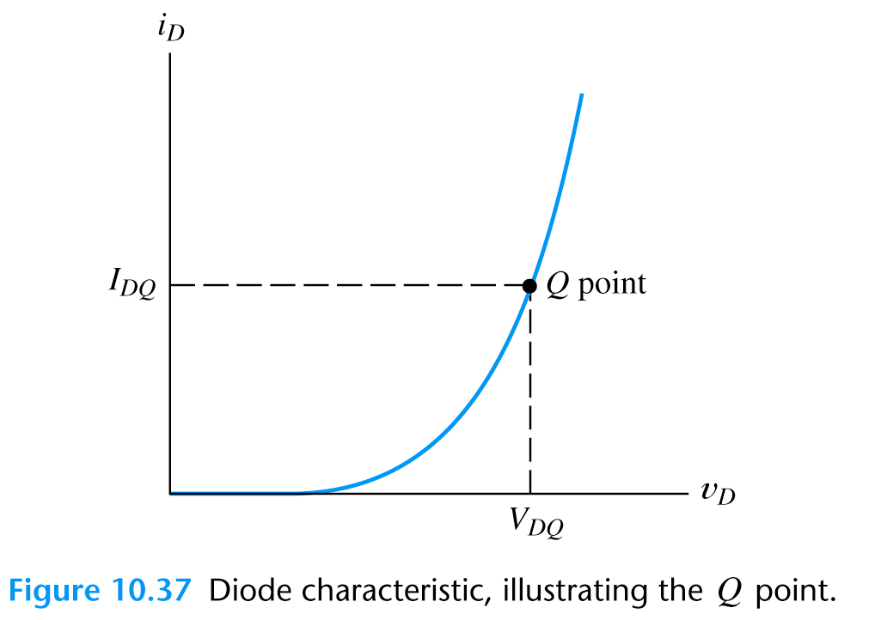
Linear Small-Signal Equivalent Circuits
In most of the electronic circuits, DC supply voltages are used to bias a nonlinear device at an operating point and a small signal is injected into the circuits.
* We often split the analysis of such circuit into two parts:
(1) Analyze the DC circuit to find operating point,
(2) Analyze the small signal (by using the “linear small-
signal equivalent circuit”.)
Small-Signal is applied by the voltage source

Slide 33
Linear Small Signal Equivalent Circuits
Since virtually any nonlinear curve is approximately linear (straight) if we consider a sufficiently small segment
THEN
We can find a linear small-signal equivalent circuit for the nonlinear device to use in the ac analysis
The small signal diode circuit can be substituted by a single equivalent resistor.

Slide 34
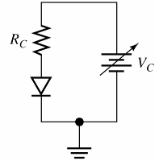
We first determine the operating point (Q point) by DC bias.
Linear Small-Signal Equivalent Circuits
A diode in linear small-signal equivalent
circuit is simplified to a resistor.
* When small AC signal injects, it swings the Q point slightly up and down.
* If the signal is small enough, the characteristic is straight.

Slide 35
Linear Small-Signal Equivalent Circuits

Slide 36
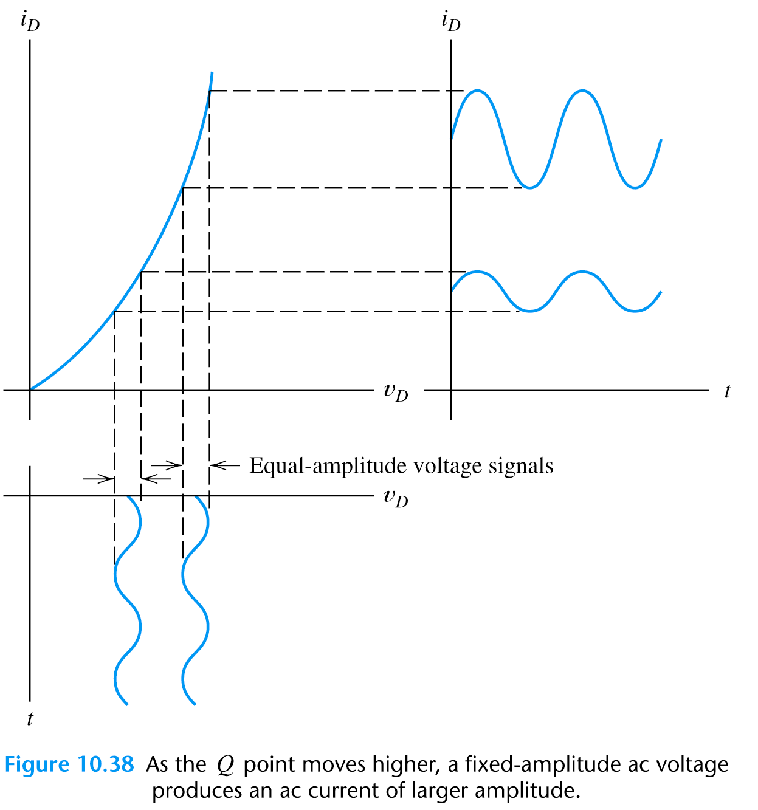
Linear Small-Signal Equivalent Circuits
* By using these two equations, we can treat diode simply as a linear resistor in small AC signal analysis.
* Note: An AC voltage of fixed amplitude produces different AC current change at different Q point.

Slide 37
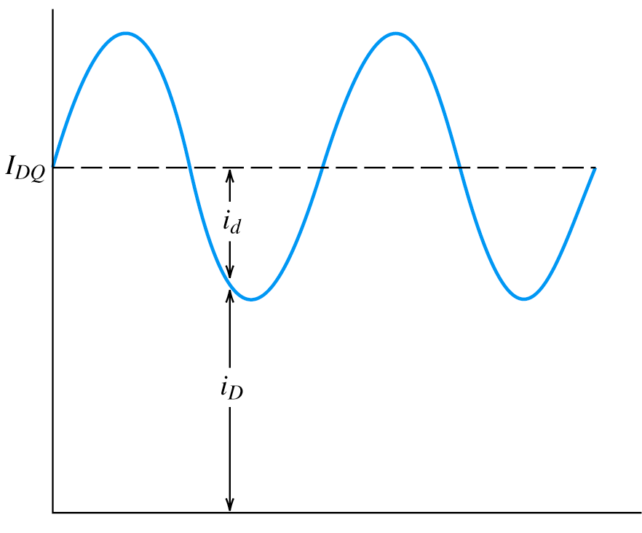
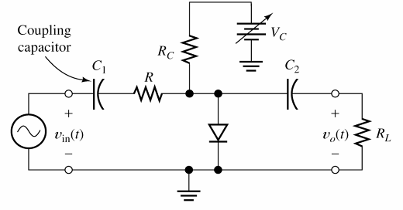
Linear Small-Signal Equivalent Circuits

Slide 38
Voltage-Controlled Attenuator
The function of this circuit is to produce an output signal that is a variable fraction of the AC input signal.
Two large coupling capacitors: behave like short circuit for AC signal and open circuit for DC, thus the Q point of the diode is unaffected by the ac input and the load.

Slide 39
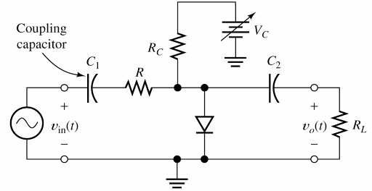
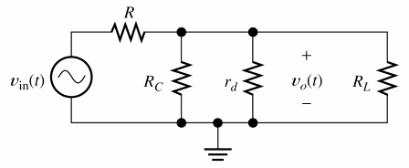
Voltage-Controlled Attenuator

Slide 40
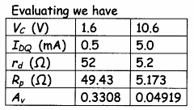
Exercise - Voltage-Controlled Attenuator

